Slide 1
Class-2
POPULATION AND DEVELOPMENT

Slide 2
RECAP
Population growth (PG): Concept and definition
Population growth and economic growth: positive relationship
Population growth and economic growth: negative relationship
Historical PG: how did it take place?
Causes of rapid growth since the Industrial Revolution?
Consequences of rapid PG
Industrialization
Urbanization
From local to global phenomenon
Hotspots: Asia, Advanced Economies, Emerging hotspots
Environmental Externalities

Slide 3
Factors affecting the distribution of population
Geographical factors
Economic factors
Social and cultural factors
Geographical factors
Access to water Sustenance of life
Landform Terrain suitability
Climate Suitable for food production
Soil (quality) Suitable for food production
Economic factors
Minerals Access to resources
Urbanization Where people live
Industrialization Access to employment
Social, cultural & governance factors
Religious centres
Cultural heritage
Political driven decisions

Slide 4
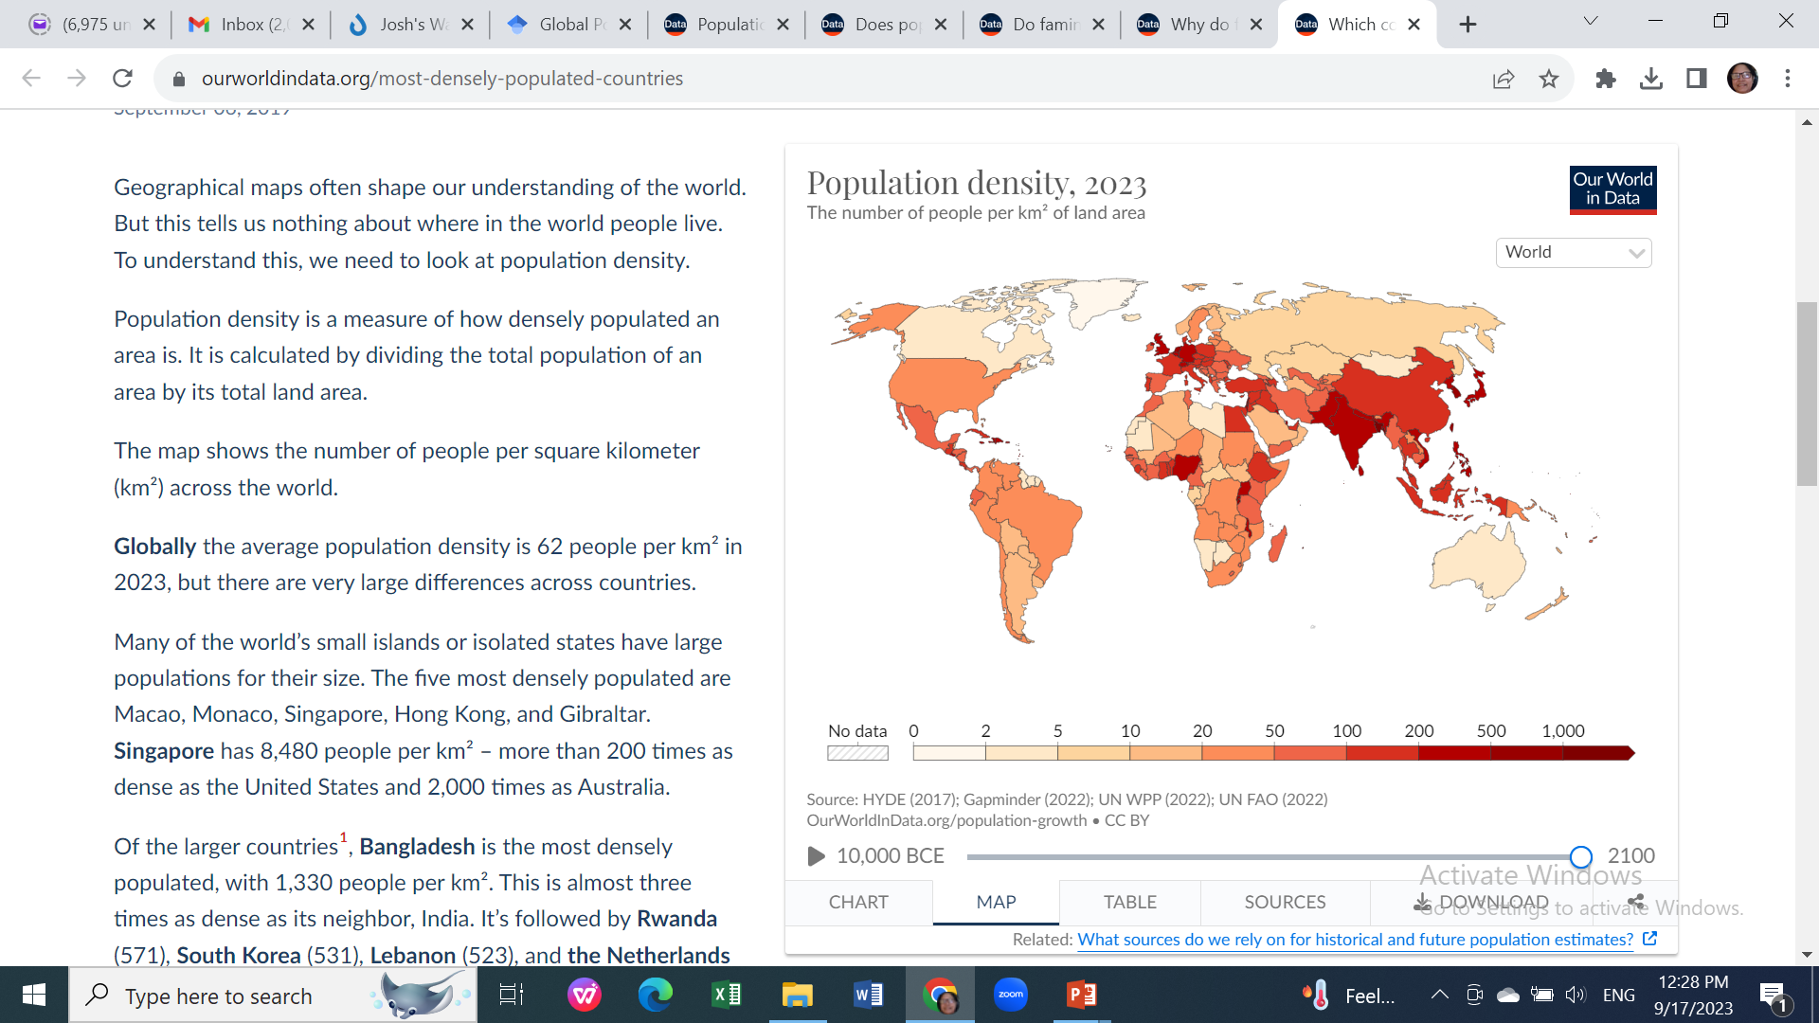
Population density is a measure of how densely populated an area is.
It is calculated by dividing the total population of an area by its total land area.
The current global average is about 62 people/sq Km.
Spatial differences are striking!
The case of city states (Macao, Monaco, Singapore, Hong Kong, and Gibraltar).
Bangladesh (1,330); Rwanda (571); S. Korea (531); Lebanon (523) & the Netherlands (517).
Source: Ritchie & Mathieu, 2019

Slide 5
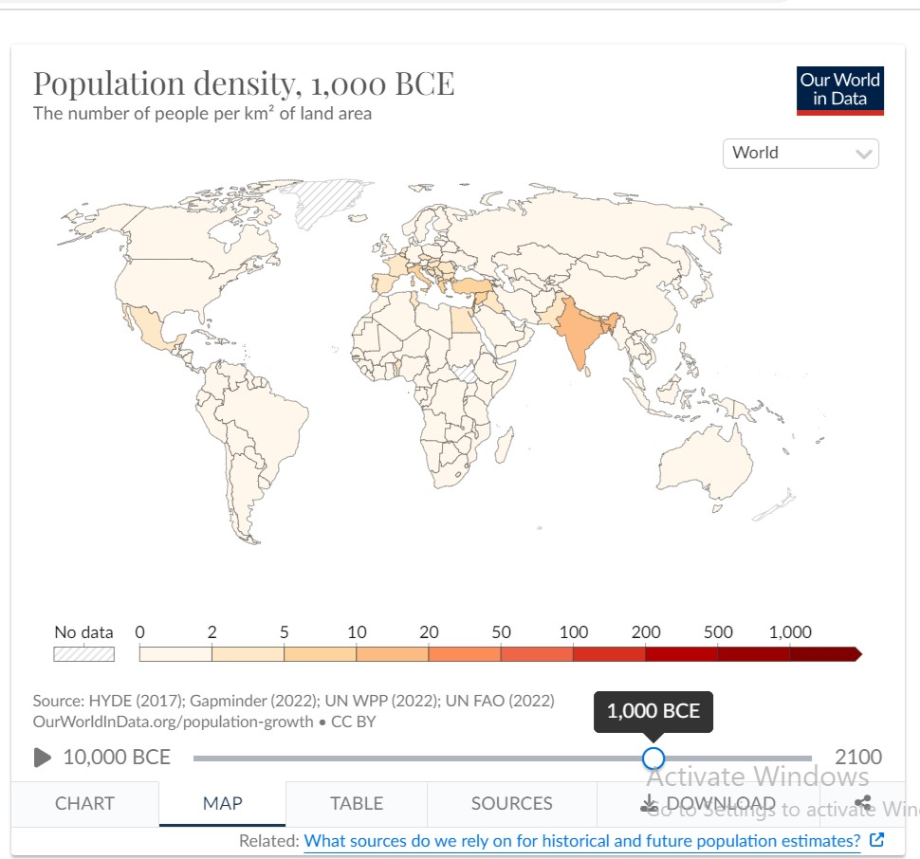
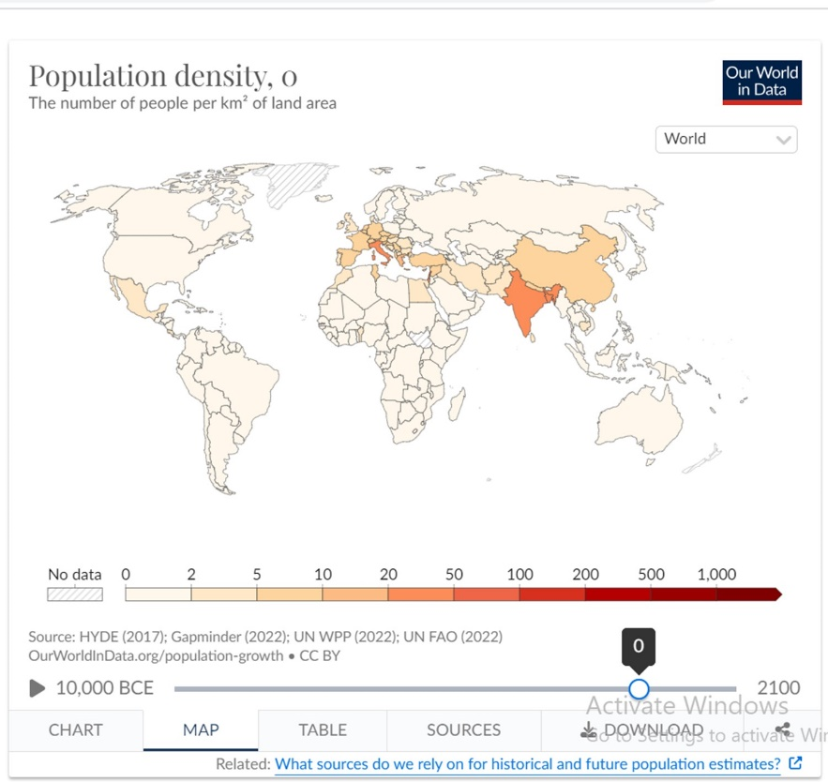
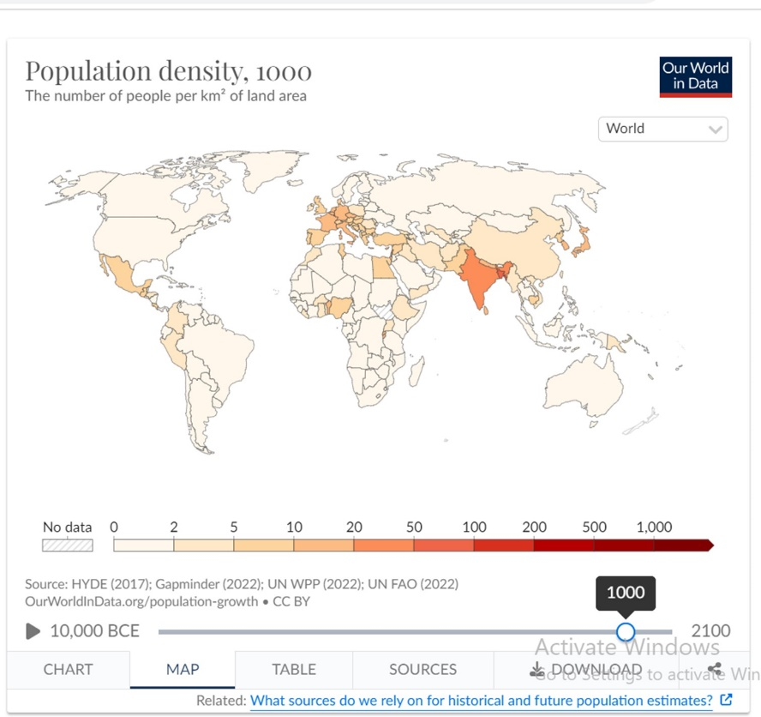
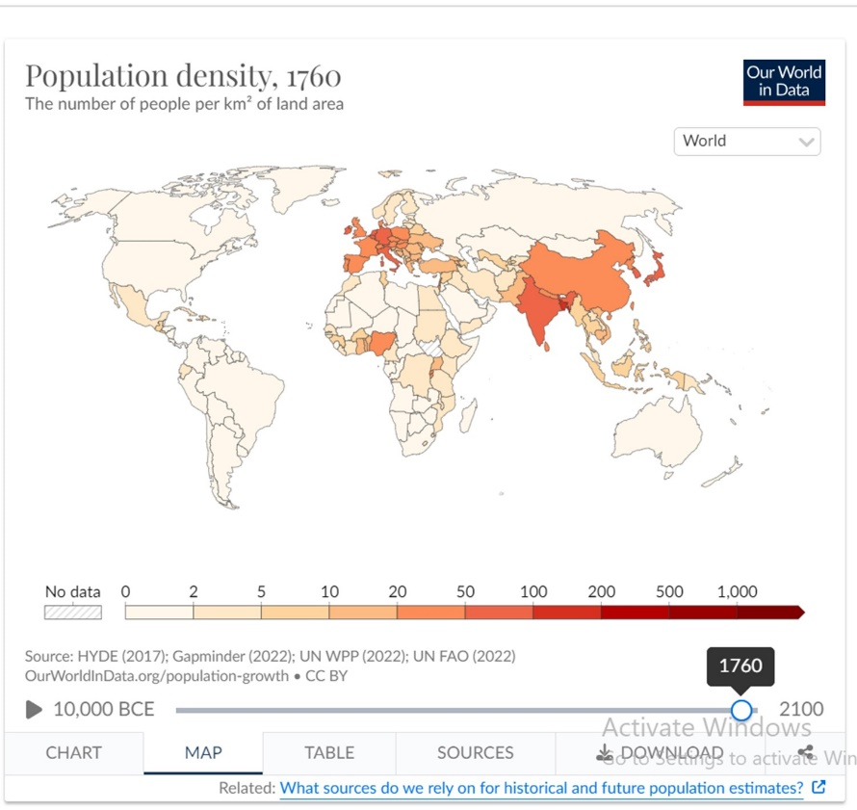
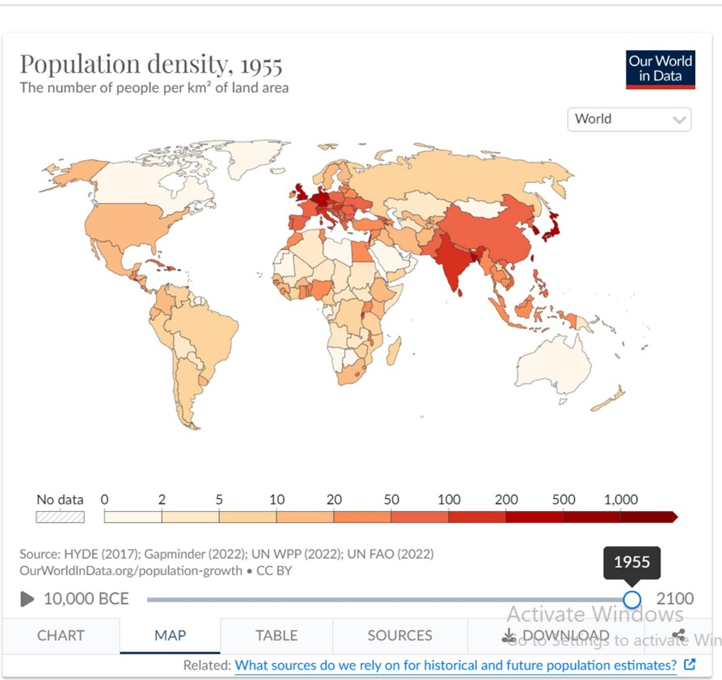
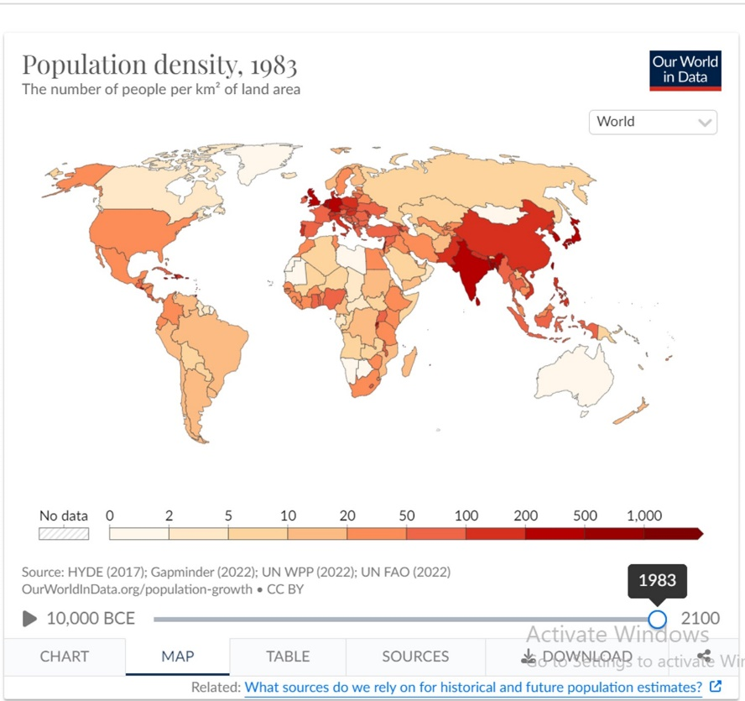
Forest
Vast land
Agricultural land
Population density: the historical build-up

Slide 6
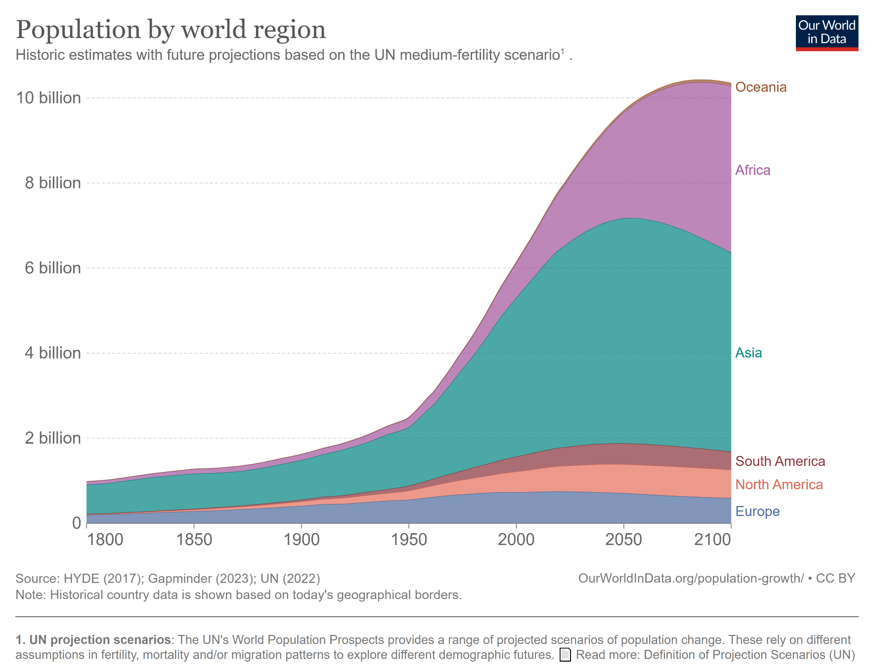
Where on earth population has been growing fast?

Slide 7
Why the global population has been growing so fast?
Innovation enabled people to find an increasing number of suitable places to live.
Efforts to have increased harvest.
Change in life expectancy – triggered by advancement in medicare facilities.
Arrest of mortality rates.
Live longer than average longevity.
Use of science and technology
Increased accessibility to resources (such as potable water)
Ability to change suitability (e.g, addressing water scarcity)
Socioeconomic factor – Financial ability and willingness to increase family size
Political and other aspects/realities (e.g, war-related deaths and uncertainties)
Whither urbanization?
Realities around poverty.

Slide 8
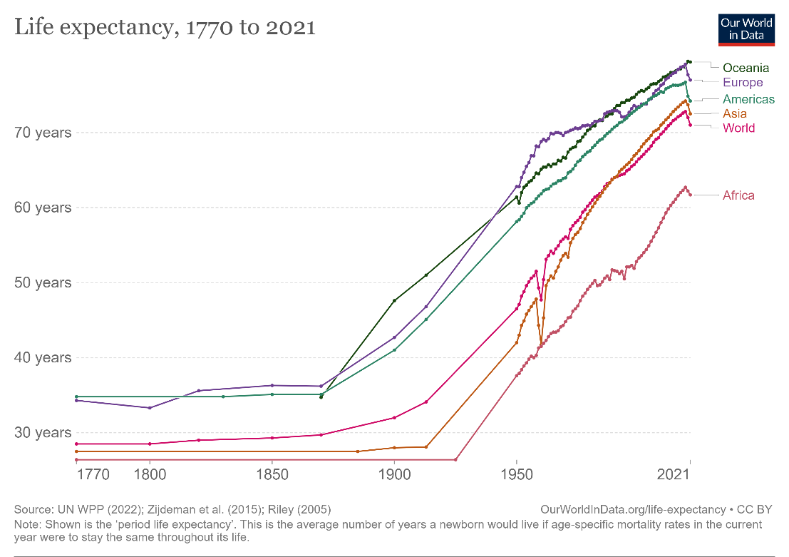
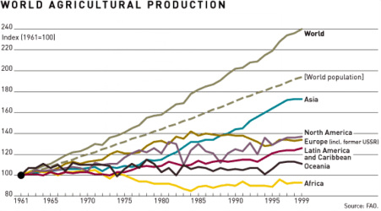
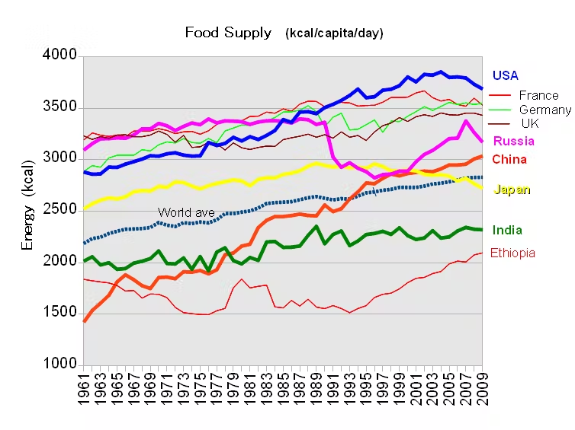
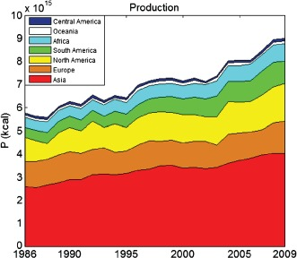
Source: Waugh
Source: J.A. Carr
Source: theconversation.com

Slide 9
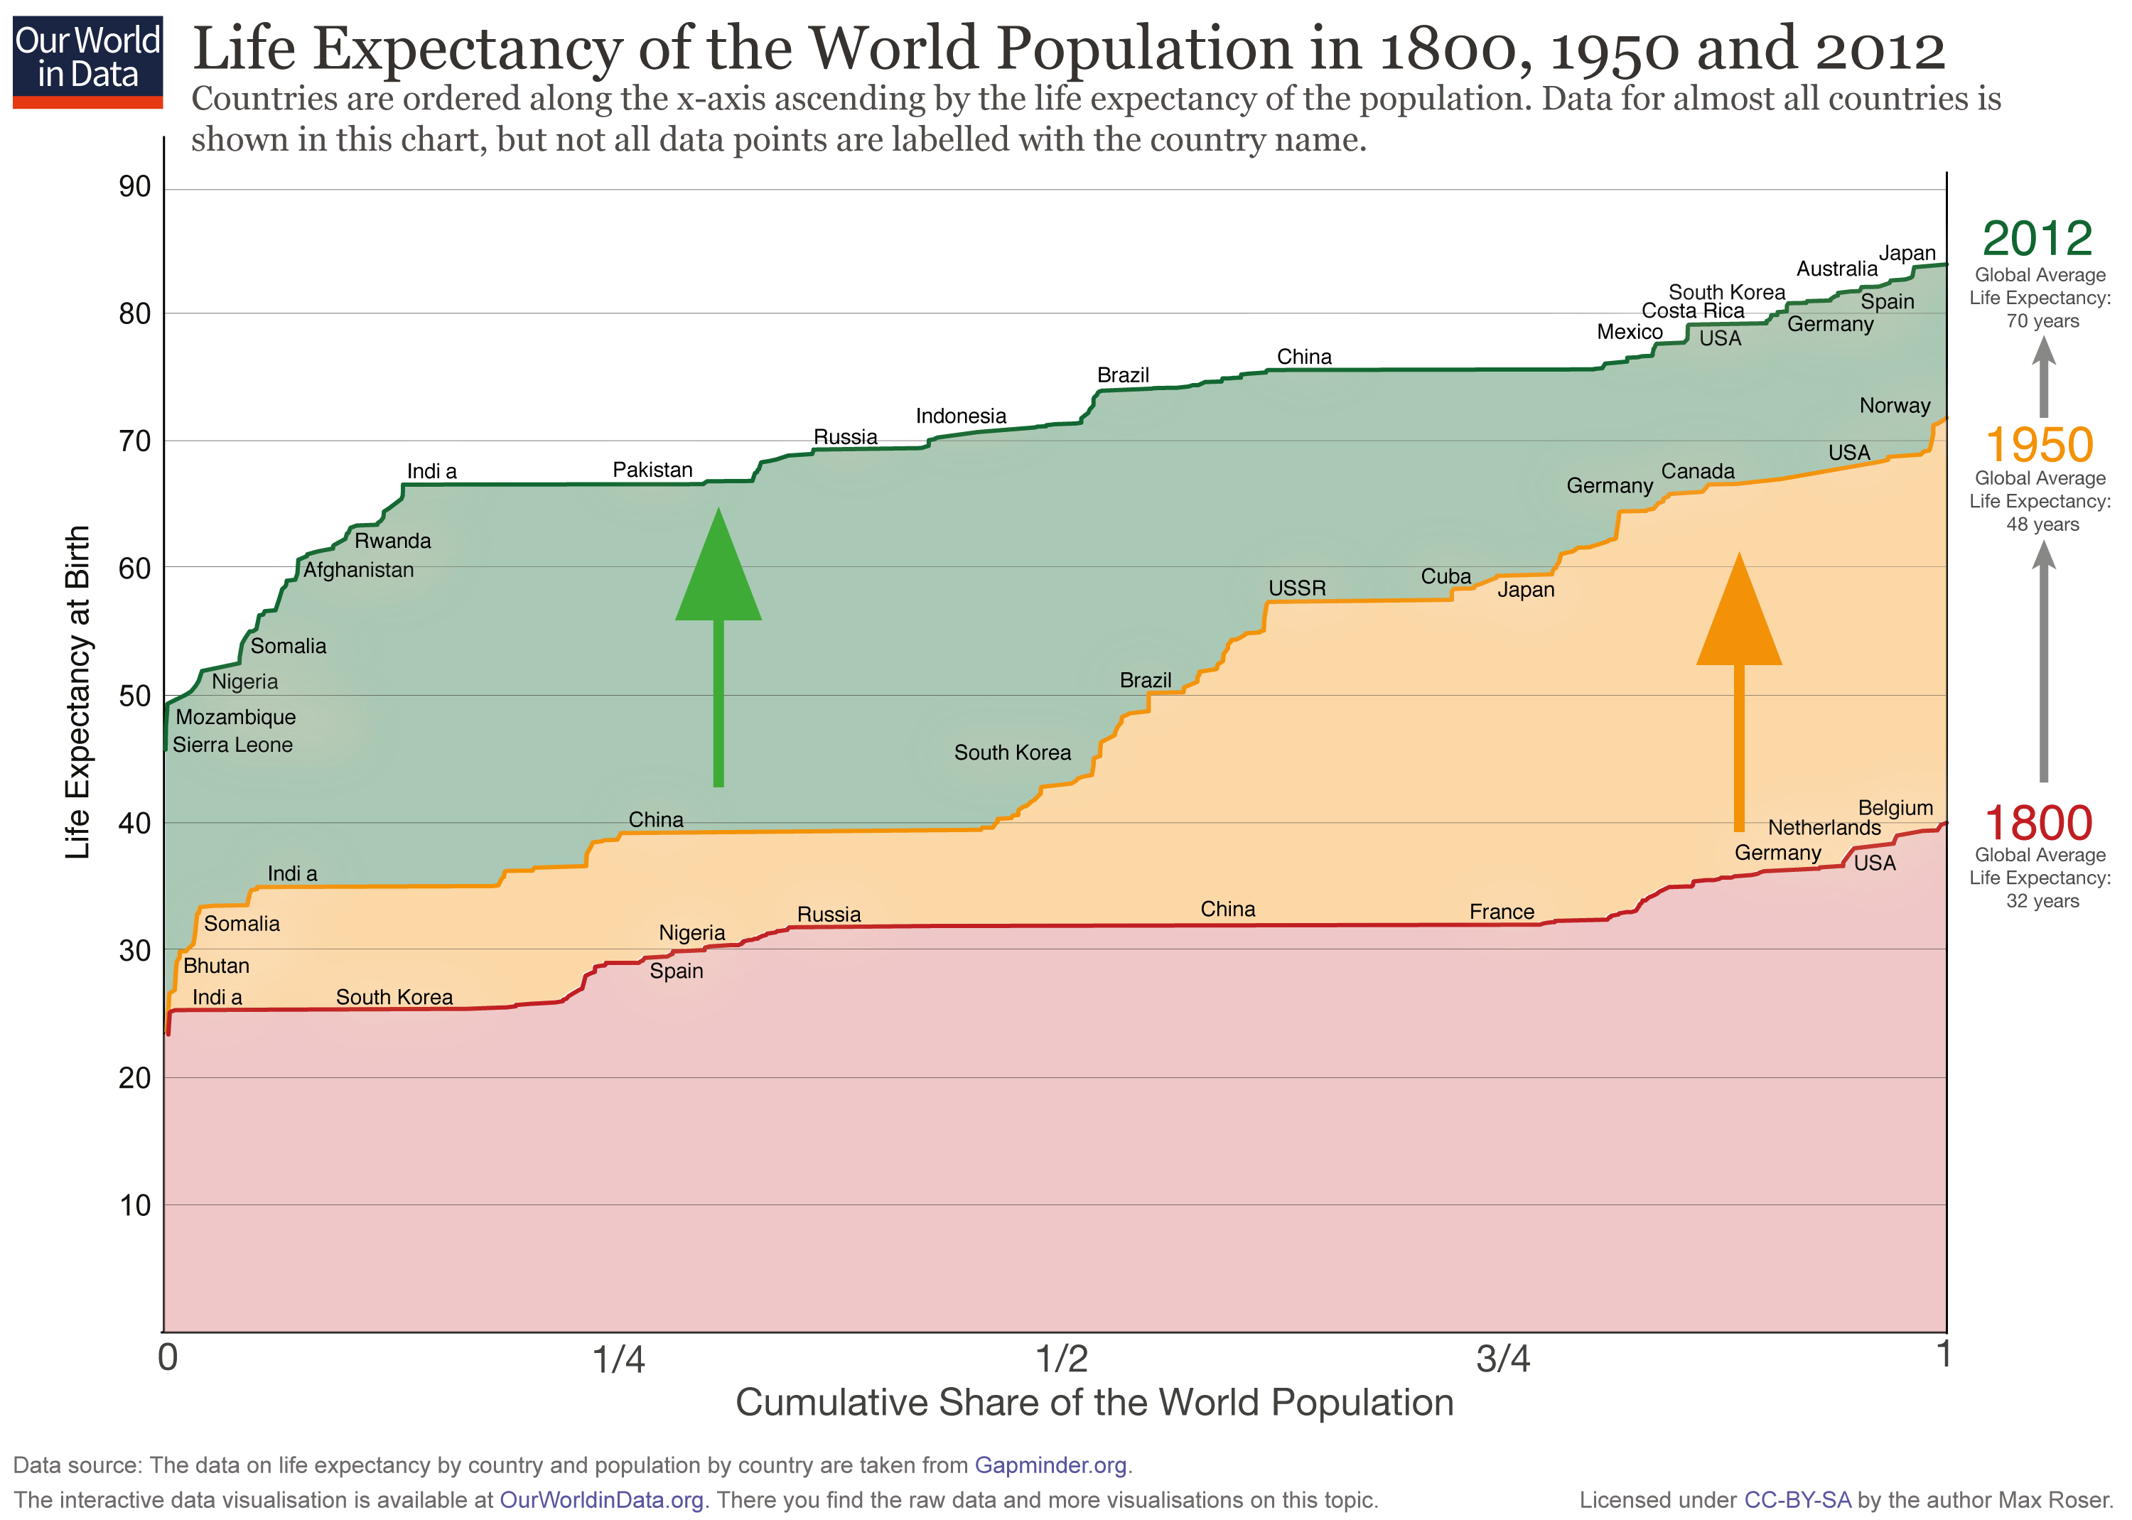

Bangladesh
Source: Roser, M., 2019

Slide 10
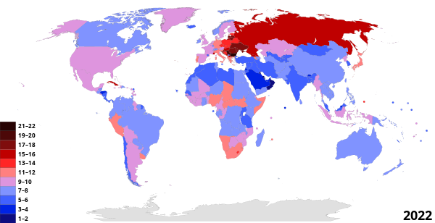
Components of population growth (revisiting)
Natural increase/decrease: Birth rate, death rate, infant mortality rate, life expectancy
Net migration: Immigration, emigration, net migration rate
Childbearing patterns: Total fertility rate, replacement level fertility
Patterns related to death: Crude death rate, age-specific death rate
Age structure (distribution of age groups): Dependency ratio, median age
Definitions
Birth rate: Birth rate, also known as natality, is the total number of live human births per 1,000 population for a given period divided by the length of the period in years.
Death rate: Death rate or mortality rate is a measure of the number of deaths (in general, or due to a specific cause) in a particular population, scaled to the size of that population, per unit of time.
Why the mortality rates in advanced economies are higher than that in South Asian countries?

Slide 11
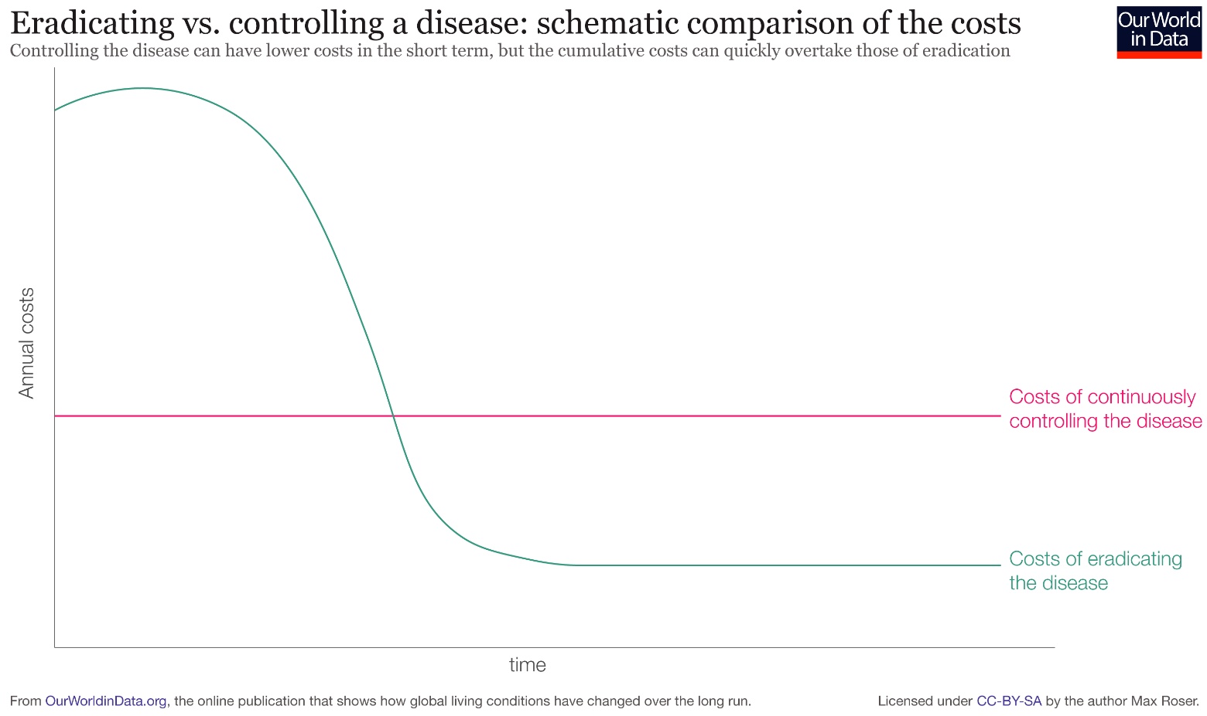
Reducing Death Rates: Fighting against diseases
Death rates have been declining across regions due to advancements in knowledge, technology, improvements in healthcare, etc.
That power has so far eradicated two infectious diseases: smallpox (1980) and rinderpest (2011). We are also getting closer to eradicating polio and Guinea worm disease.
But can we eradicate all infections from the world?
Louis Pasteur once said that “it is within the power of man to eradicate infection from the earth”.
Smallpox: From vaccine to eradication took 200 years!
Annual costs
Time

Slide 12
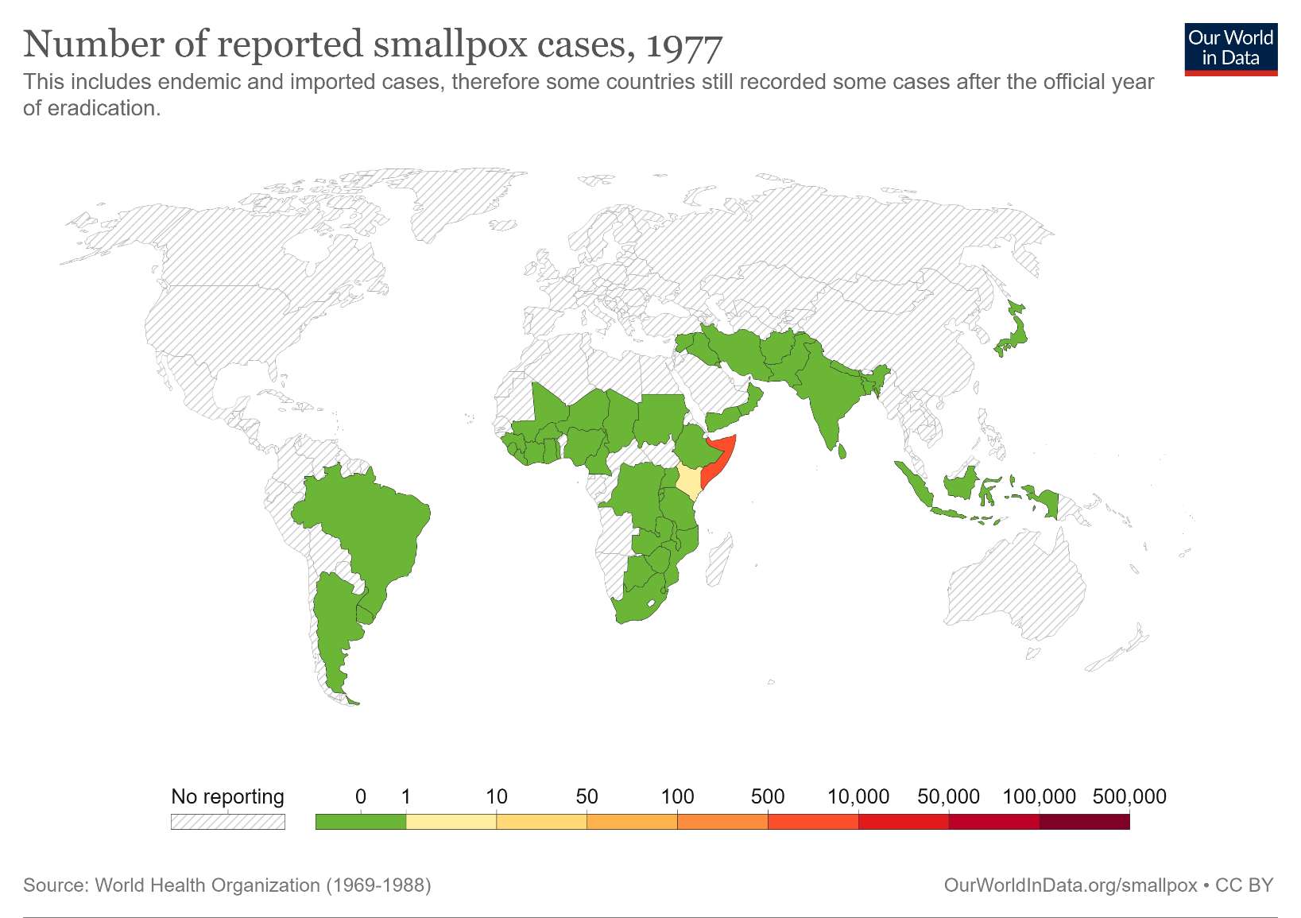
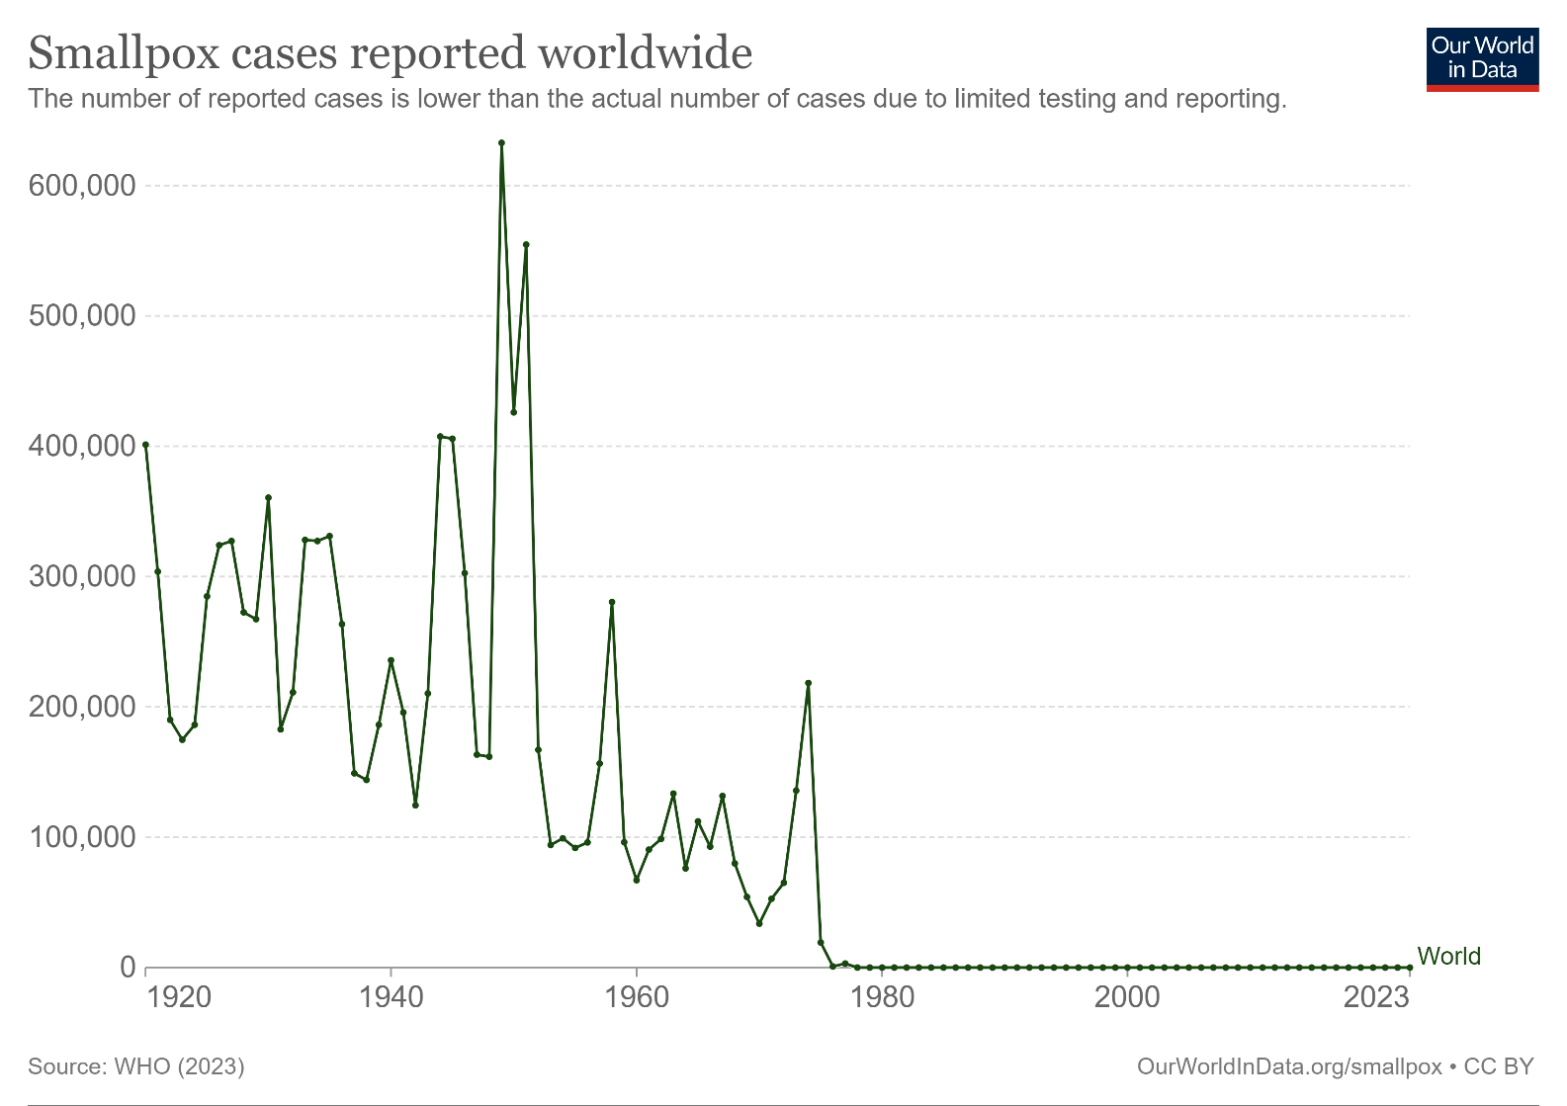
Fighting against diseases: Learning from the case of smallpox

Slide 13
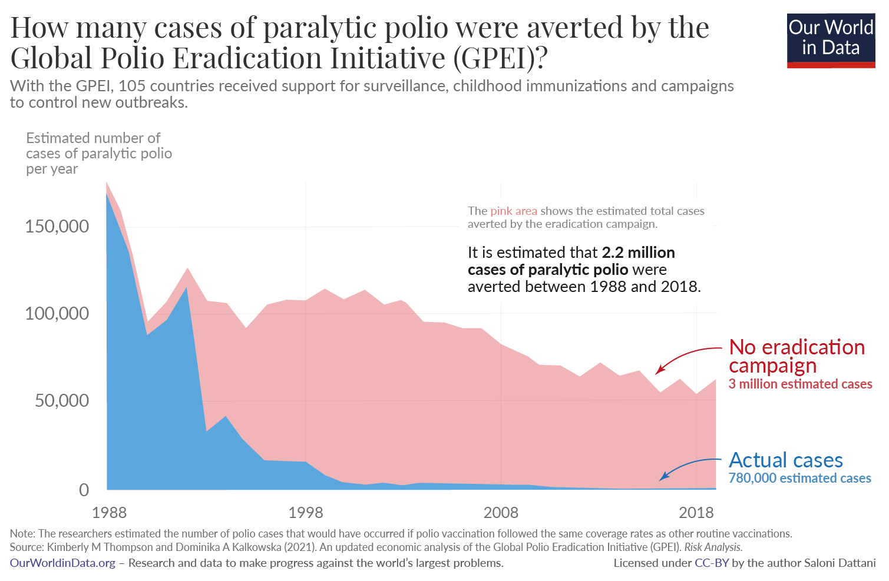
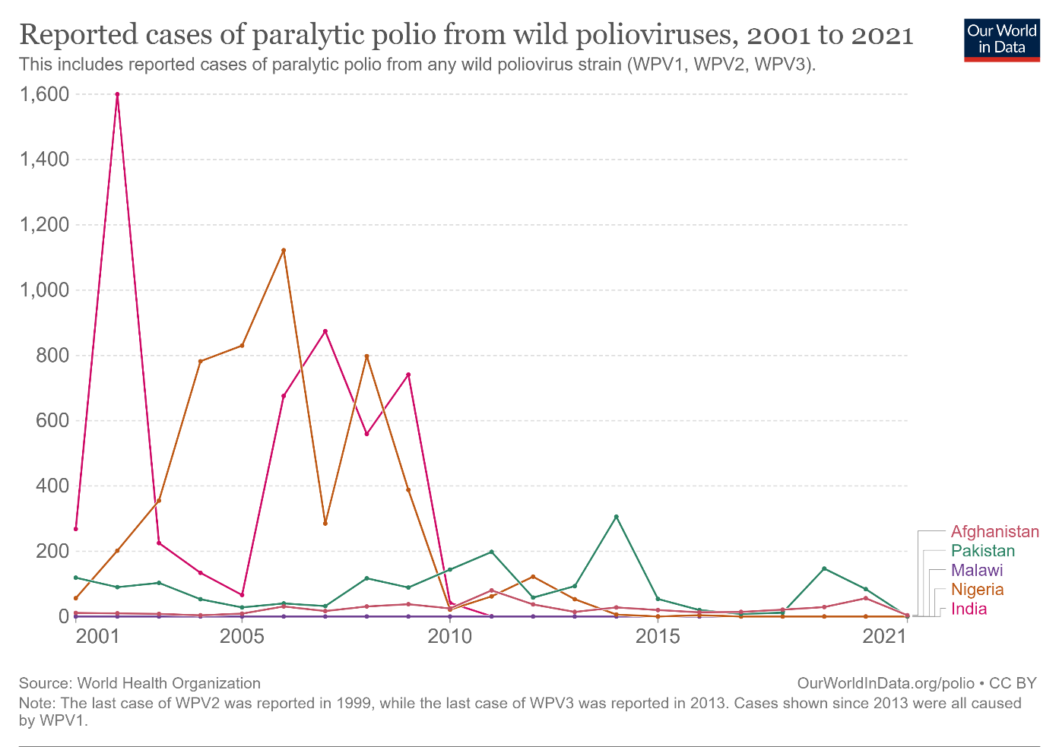
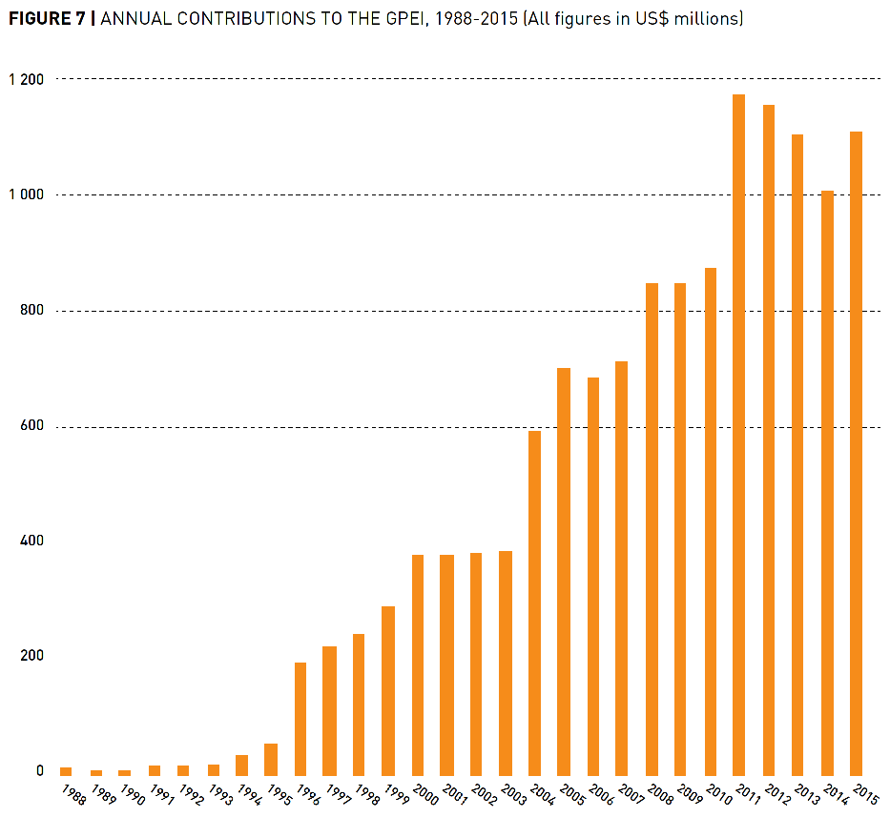
Fighting against diseases: Learning from the case of polio eradication
There has been a gradual build-up of annual contributions for the cause.
A global-scale eradication process is costly; it also takes time.
There are still a few cases of polio per year.

Slide 14
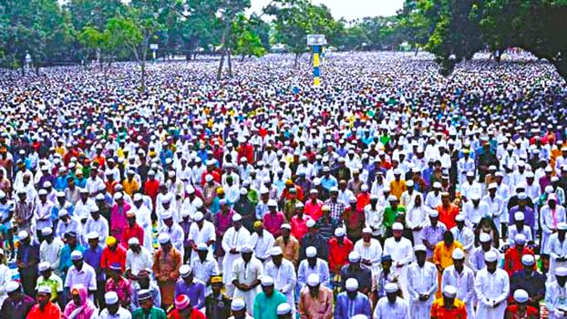
POPULATION GROWTH IN BANGLADESH

Slide 15
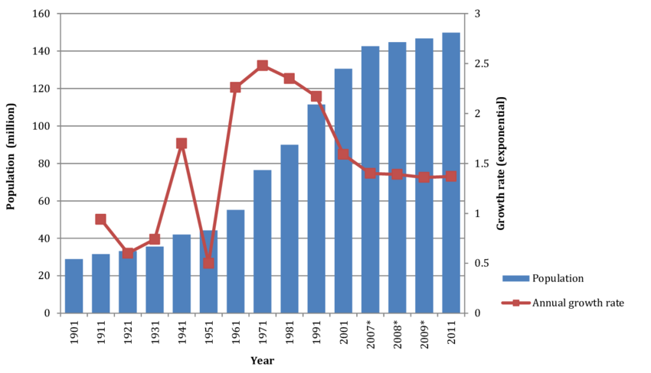
There has been a fivefold increase in population during the past century.
The growth took a dramatic turn in the 1950s.
The growth rate has started to fall in the 1970s, following the independence.

Slide 16
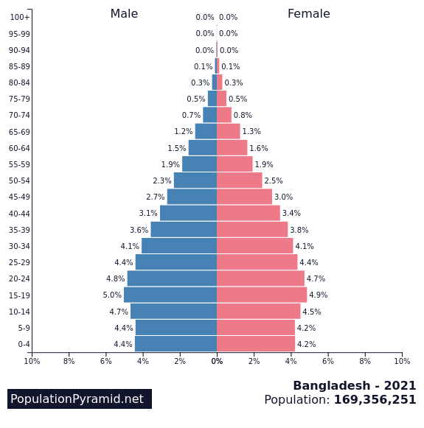
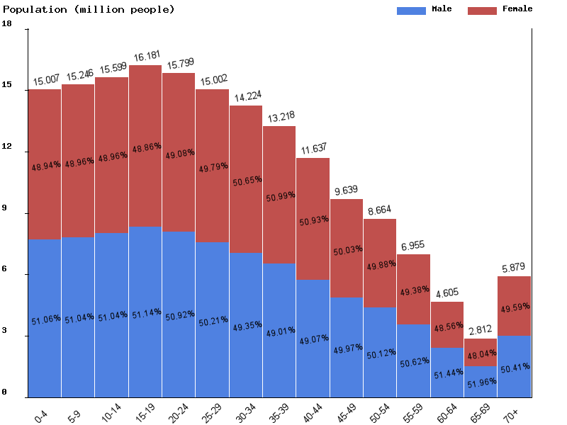
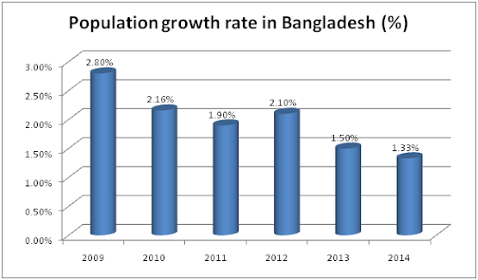
64%
Age group

Slide 17
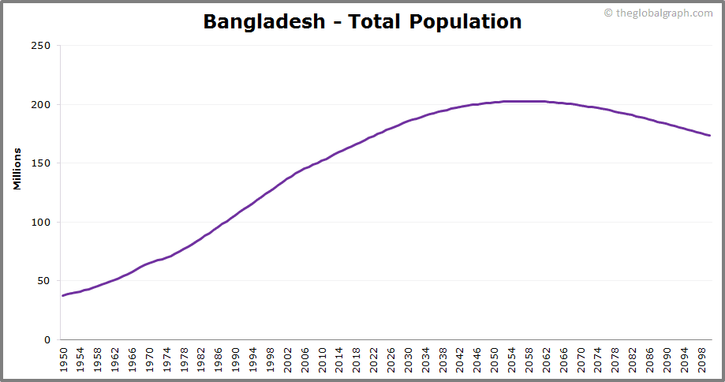
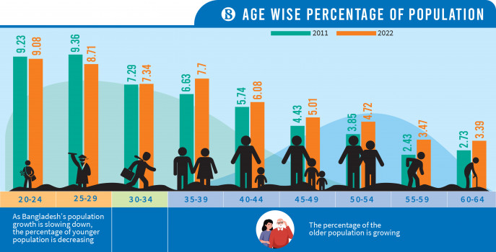
Bangladesh’s population is projected to increase until the 2050s, when the peak will arrive. Then it will start to decline.
All throughout these years till the peaking, we shall have an abundance of young population. The challenge is to keep them healthy, provide good living environment, enhance their skills through quality education – so that they become both productive and competitive.

Slide 18
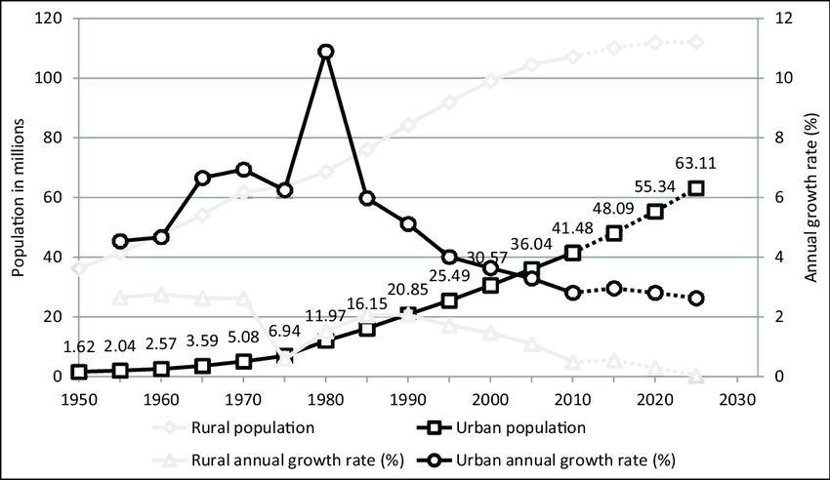
Rural and Urban Population Growth Trends in Bangladesh
From now on, the increment in population will be observed in urban areas, since rural PGR has declined to net zero.
Emergence of a few more megacities is on the cards!
Are our cities ready for accommodating the additional 33 million people in about 3 decades?
Source: Ahmed, S., 2014

Slide 19
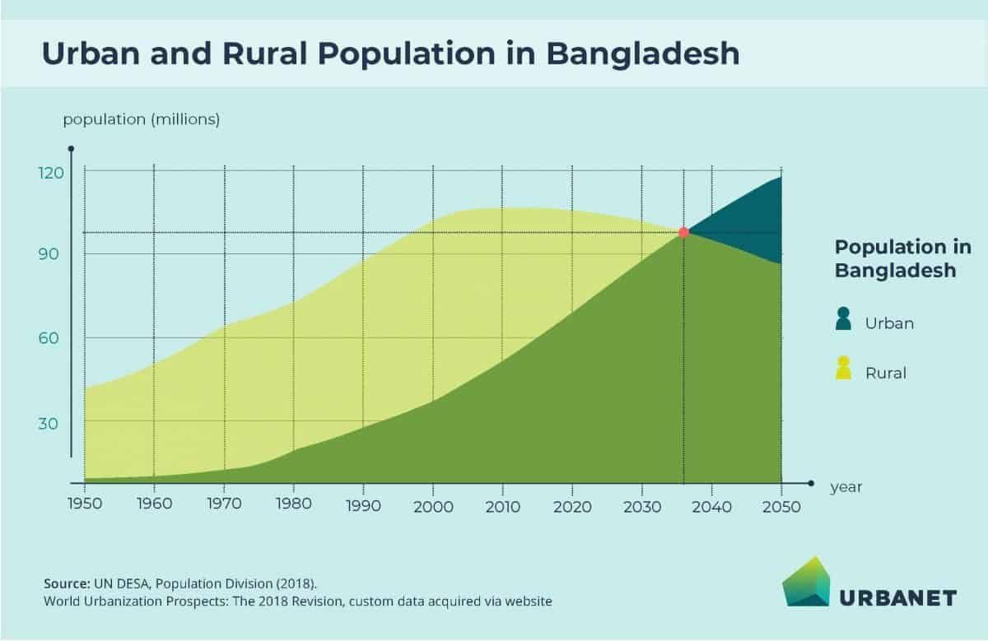
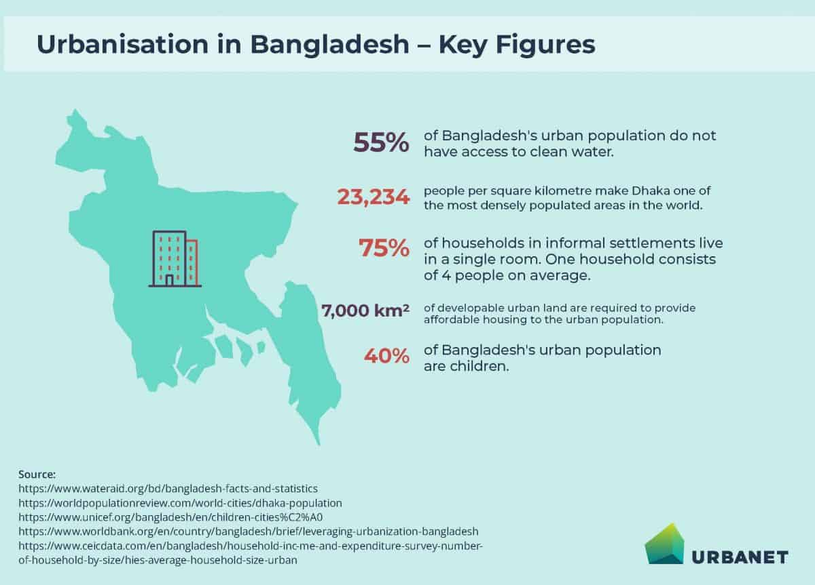
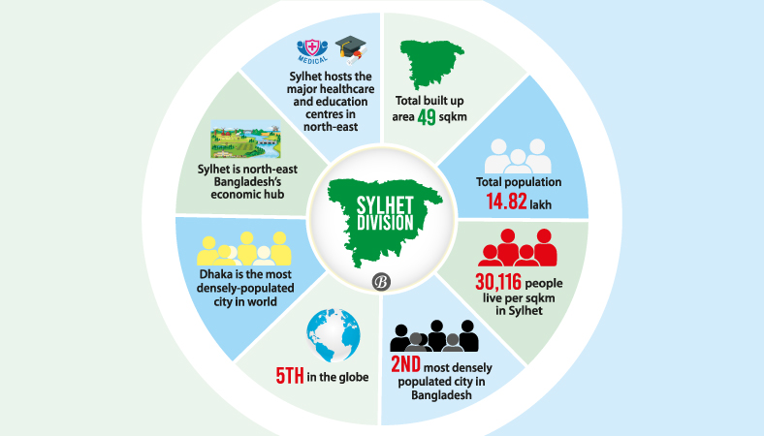
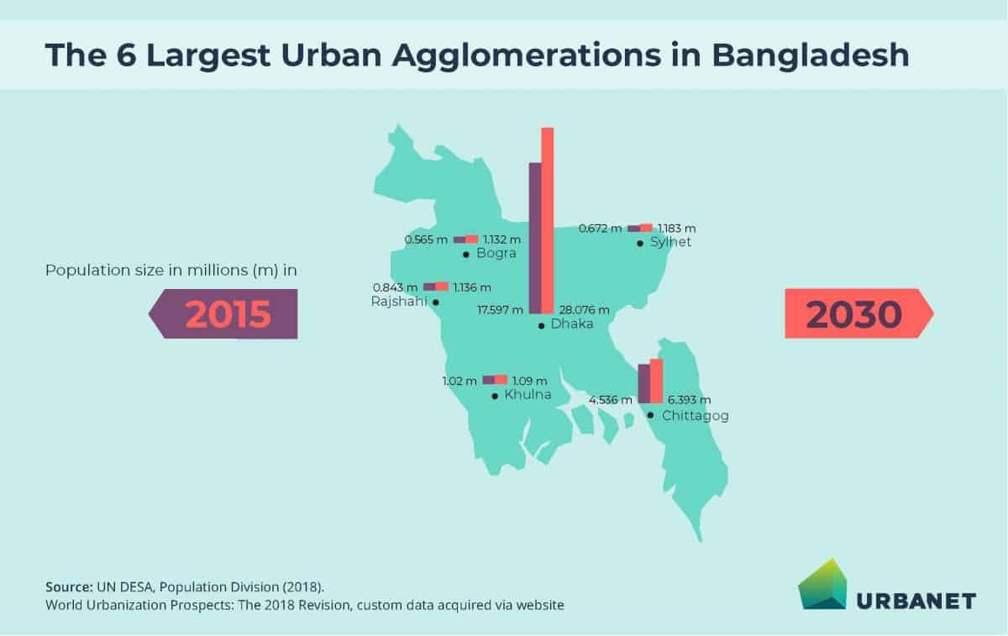
Source: Amin, M.A., 2021

